Slide 1
Logix Home PCB

Slide 2
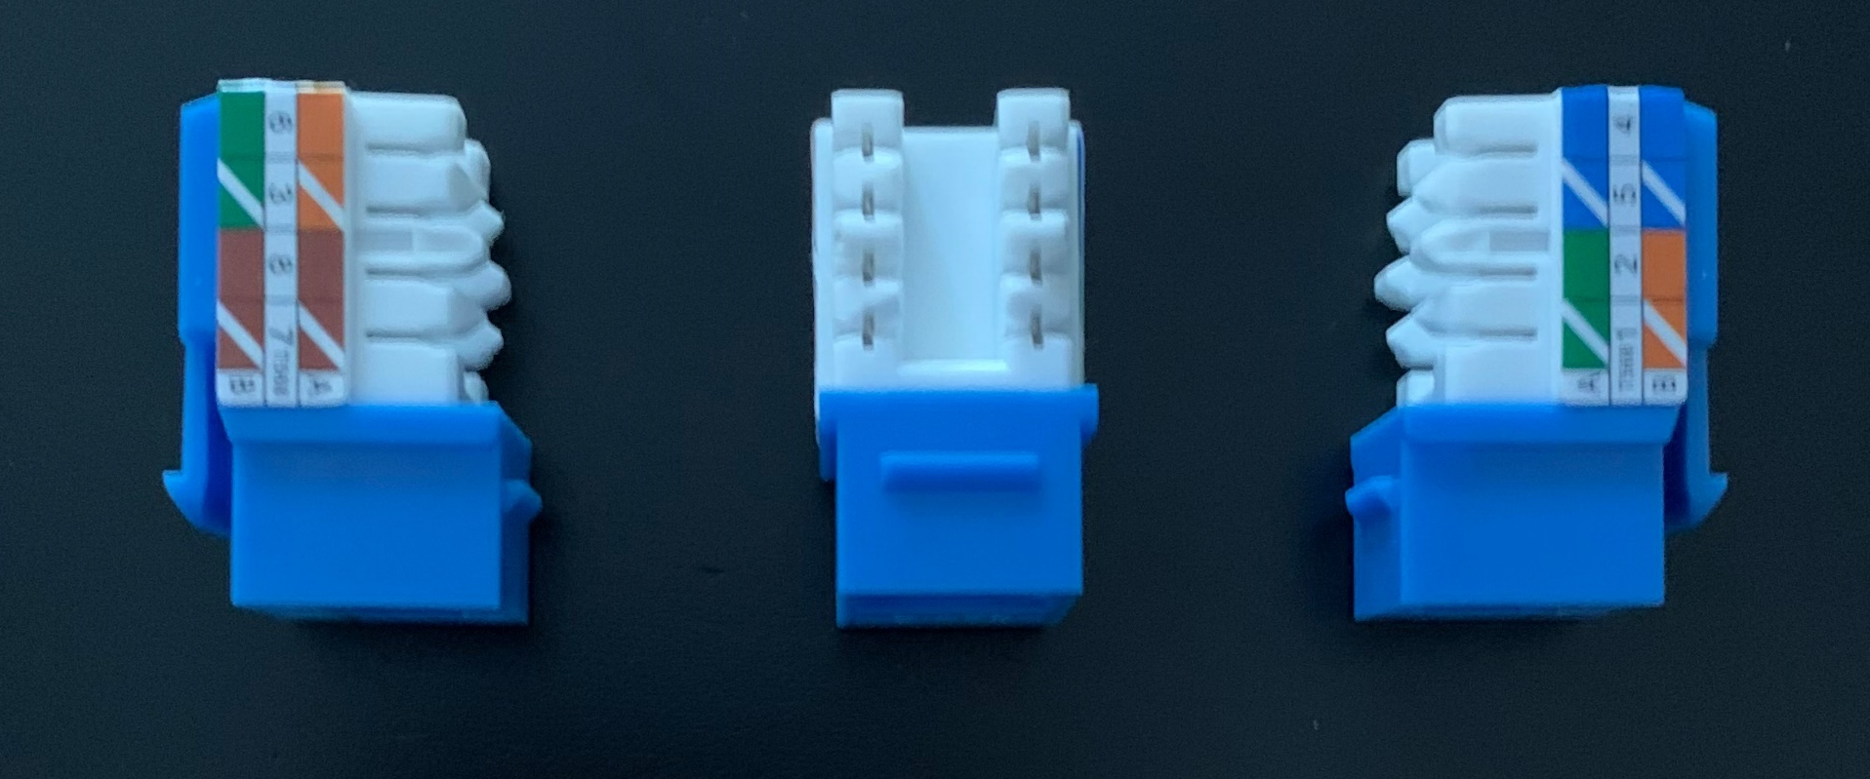
Orange = SENSOR1
Orange/White (GRND)
Brown = SENSOR2
Brown/White (GRND)
Blue = SENSOR3
Blue/White (GRND)
Green = SENSOR4
Green/White (GRND)
When I was confronted with a hoard of wire sticking out the wall where the alarm panel used to exist, it was a task itself to determine which wires went to which sensors. In my case there were 12 zones broken down as follows:
4 doors (front/back/garage entry/basement)
8 windows (living room/dining room/kitchen/bath/family room/basement/basement side)
I would note some of the windows were in pairs and had their own sensors but counted as 1 zone per pair)
I used Network RJ45 connectors to connect the wire pairs to. Each cable that was prewired had 4 wires (red/black/green/yellow)

Slide 3


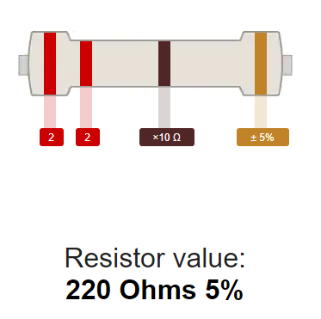
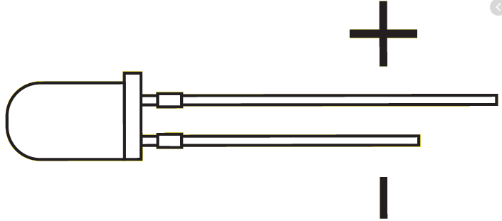
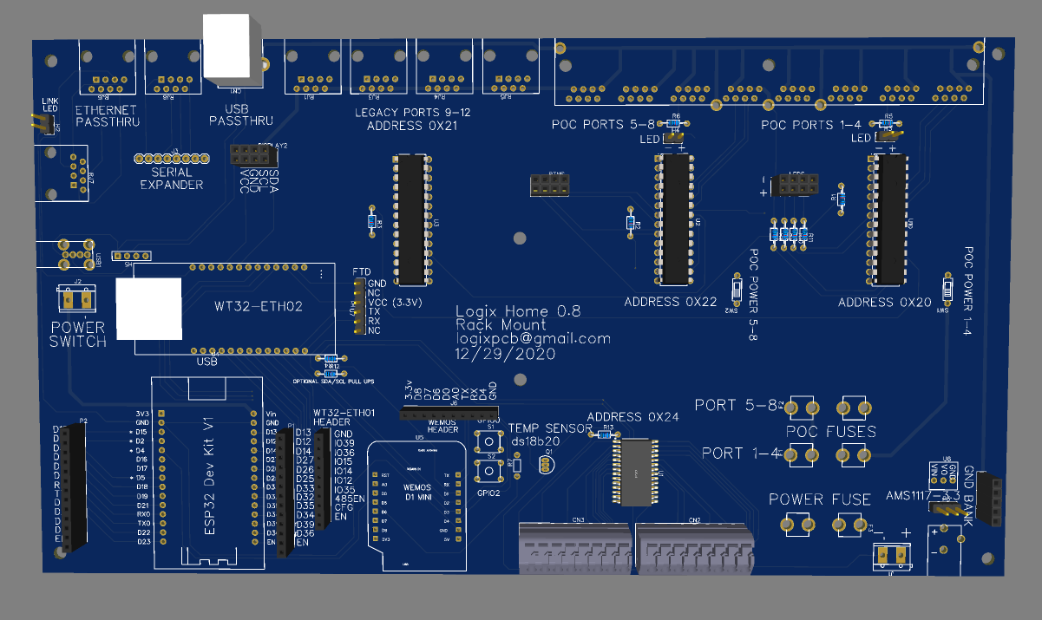
10K resistor
12-15
8-11
4-7
0-3
D5 (GPIO14)
ds18b20
*reverse of diagram

